Slide 1
Mr. Bhavesh Gunjal
Ms. Kumari Shweta
Ms. Leema Devi
Mr. Mangesh Kokare
Ms. Namrata Singh
Mr. Vinay Sagar

Slide 2
FUNDAMENTALS
OF
HARDWARE

Slide 3
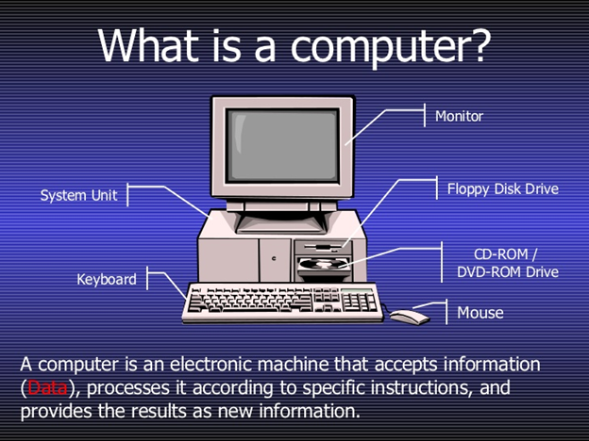
What is Computer?
A computer is an electronic machine that accepts information(data), process it according to specific instructions, and provides the new results as new information.

Slide 4
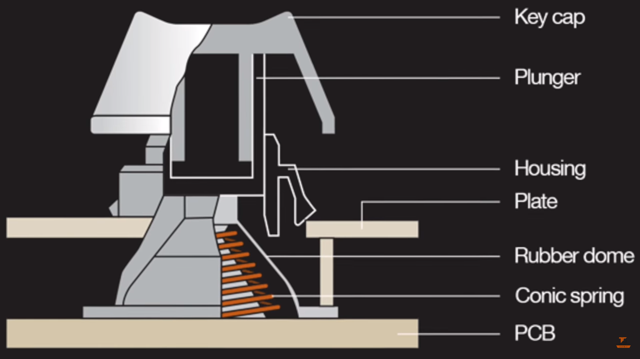
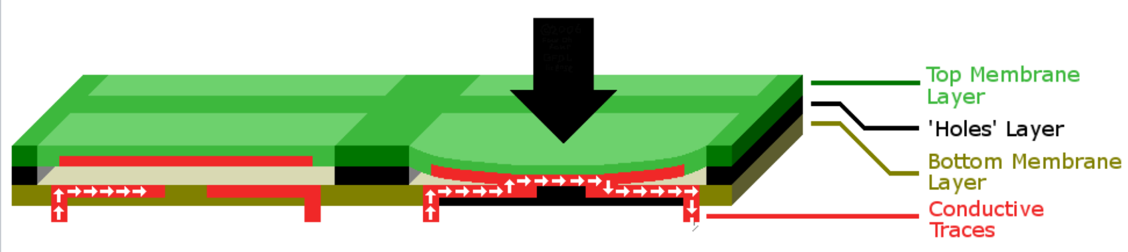
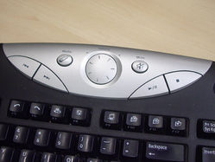
Keyboard
Mechanical Keyboard
Membrane Keyboard
Multimedia Keyboard

Slide 5
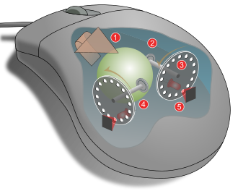
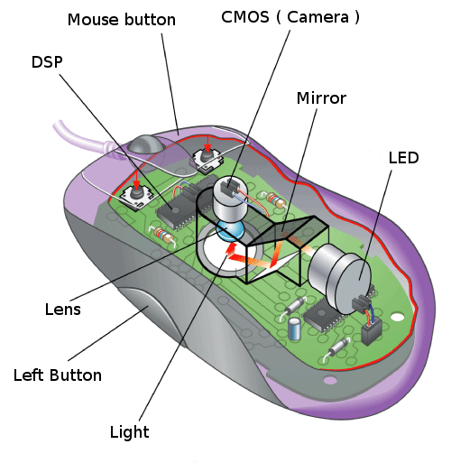
Scanner
Mechanical Mouse
Optical Mouse

Slide 6
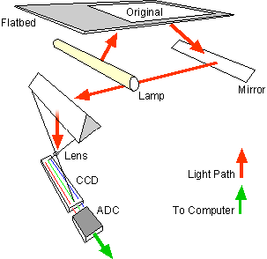
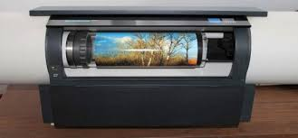
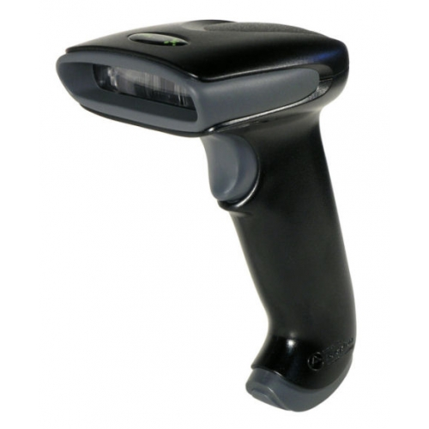
Scanner
Flatbed Scanner
Drum Scanner
Handheld Scanner

Slide 7
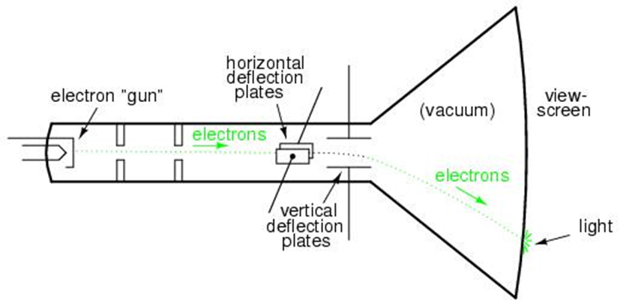
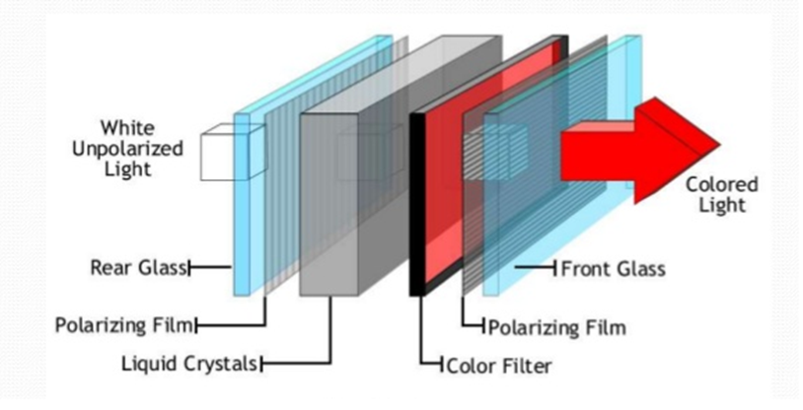
Monitor
CRT Monitor
LCD Monitor

Slide 8
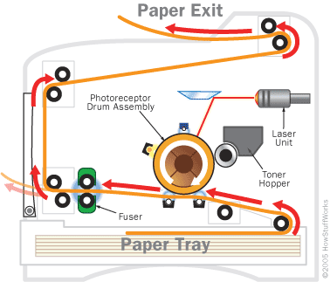
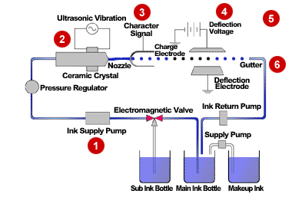
Printer
Laser Printer
Inkjet Printer

Slide 9
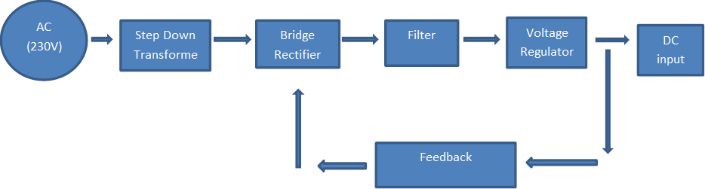
SMPS
AC to DC Converter SMPS Working Principle
Notes:
A cor AZUL sempre tem que aparecer no slide. Seja nas formas ou no texto.
Uma imagem como essa nao funciona. Muito “Barbie” para uma consultoria. Eles gostam deste layout mas deveria estar separador de capitulos com o logo de “espadas” maior. Para toda insercao de imagem o fundo deve ser cinza claro.

Slide 10
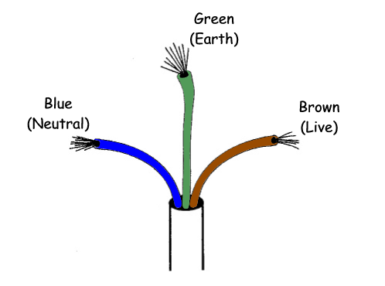
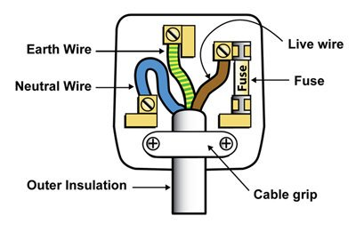
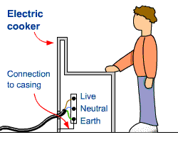
Earthing
Notes:
A cor AZUL sempre tem que aparecer no slide. Seja nas formas ou no texto.
Uma imagem como essa nao funciona. Muito “Barbie” para uma consultoria. Eles gostam deste layout mas deveria estar separador de capitulos com o logo de “espadas” maior. Para toda insercao de imagem o fundo deve ser cinza claro.

Slide 11
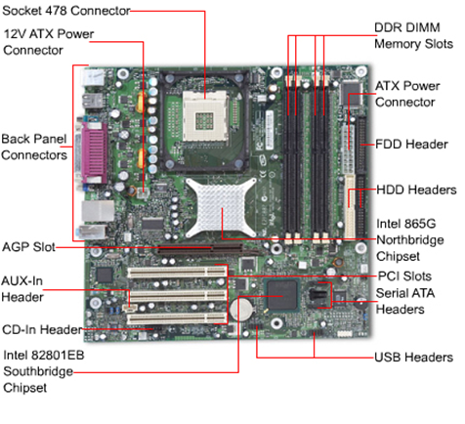
Motherboard
Types of Motherboard :
ATX motherboard
Full AT motherboard
Baby AT motherboard

Slide 12
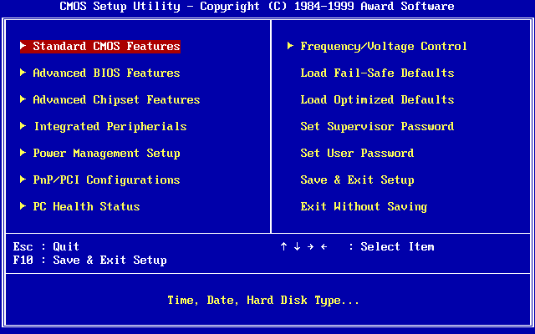
BIOS
1. Check the CMOS Setup for custom settings.
2. Load the interrupt handlers and device drivers.
3. Initialize registers and power management.
4. Perform the power-on self-test (POST).
5. Display system settings.
6. Determine which devices are bootable.
7.Initiate the bootstrap sequence.

Slide 13
FUNDAMENTALS
OF
WINDOWS

Slide 14
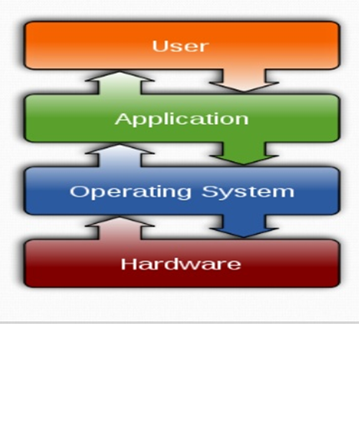
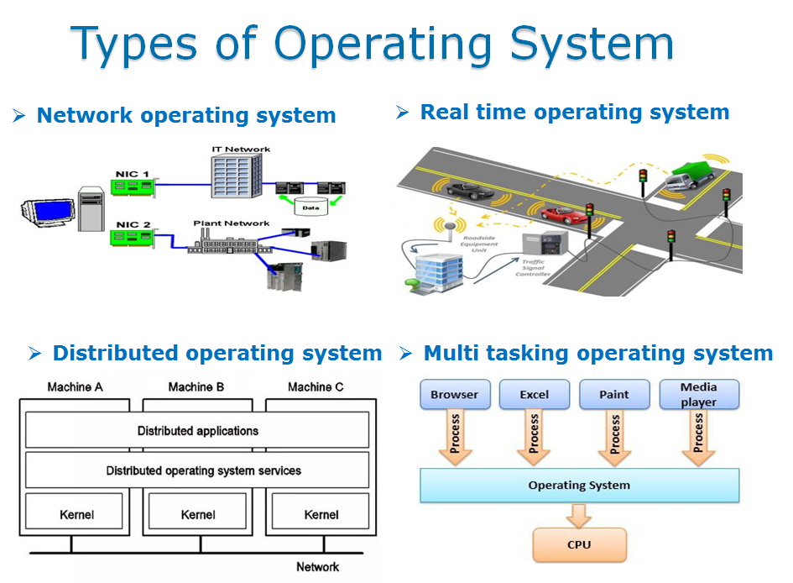
Operating System and its types

Slide 15
It is a Computer program which is the core of the OS with complete control.
It is the program Loaded on startup and handles request.
Types of kernel
Monolithic kernels
OS completely runs on kernel mode.
Runs entirely in a single address space.
● Microlithic kernels
OS completely runs on user mode
The kernel is broken down into separate process and run in different address space.
● Hybrid kernels
It is a combination of both.
kernel

Slide 16
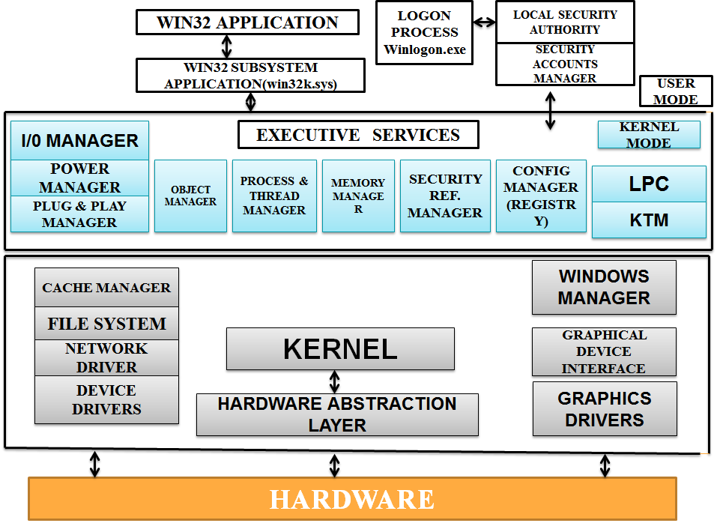
Kernel Architecture

Slide 17
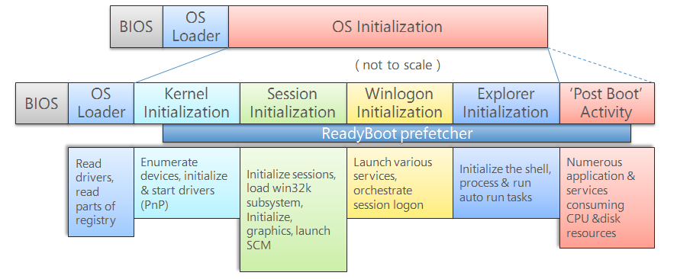
Booting Process

Slide 18
SMPS
Ntoskrnl.exe
Phase 0
Winlogon.exe
Ntoskrnl.exe
Phase 1
logonUI.exe
BIOS (POST)
MBR
Smss.exe
dwm.exe
Csrss.exe
Bootmgr
Userinit.exe
Winresume.exe
Wininit.exe
Winload.exe
Explorer.exe
Services.exe
Lsass.exe

Slide 19
File System
Storing and retrieving data from a storage device.
File systems can be used on numerous different types of storage devices that use different kinds of media.
The most common storage device in use today is a hard disk drive.
Files separated into groups called directories.

Slide 20
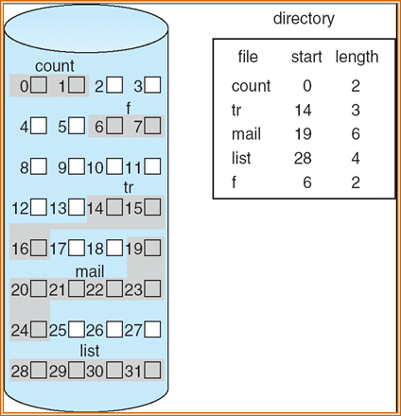
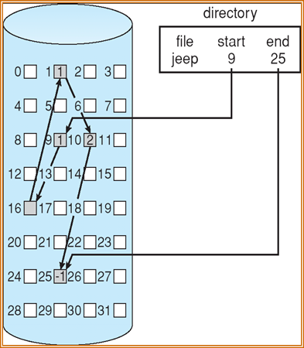
ALLOCATION OF METHODS (OF DATA BLOCKS)
Contiguous Allocation
Linked Allocation

Slide 21
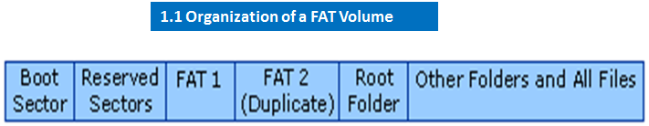
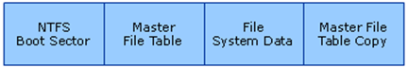
Types of File system
FAT32
NTFS

Slide 22
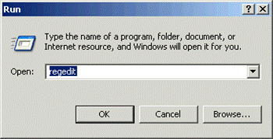
Windows Registry
The registry is a hierarchical database that stores low-level settings for the Microsoft Windows operating system and for applications that opt to use the registry.
The kernel, device drivers, services, Security Accounts Manager (SAM) and user interface can all use the registry.

Slide 23
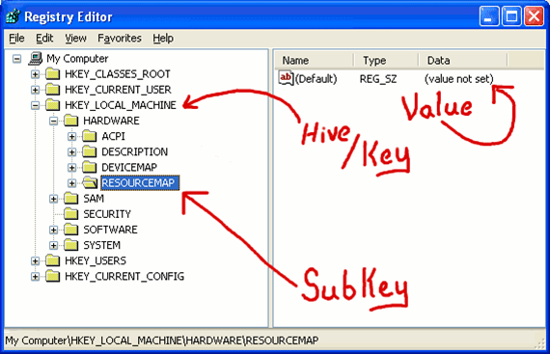
Structure of Registry
The registry contains two basic elements: keys and values.
Keys may contain values and subkeys.
A hive is a logical group of keys, subkeys, and values in the registry.
There are five hives of the registry:
HKEY_LOCAL_MACHINE
HKEY_CURRENT_CONFIG
HKEY_CLASSES_ROOT
HKEY_CURRENT_USER
HKEY_USERS

Slide 24
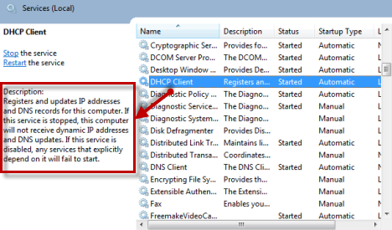
Services
A Windows service is a computer program that operates in the background.
The Service Control Mechanism maintains database of the installed services and driver services that allow the Operating System to start successfully and provides a unified and secure means of controlling them.
System administrators use services like snap-in.

Slide 25
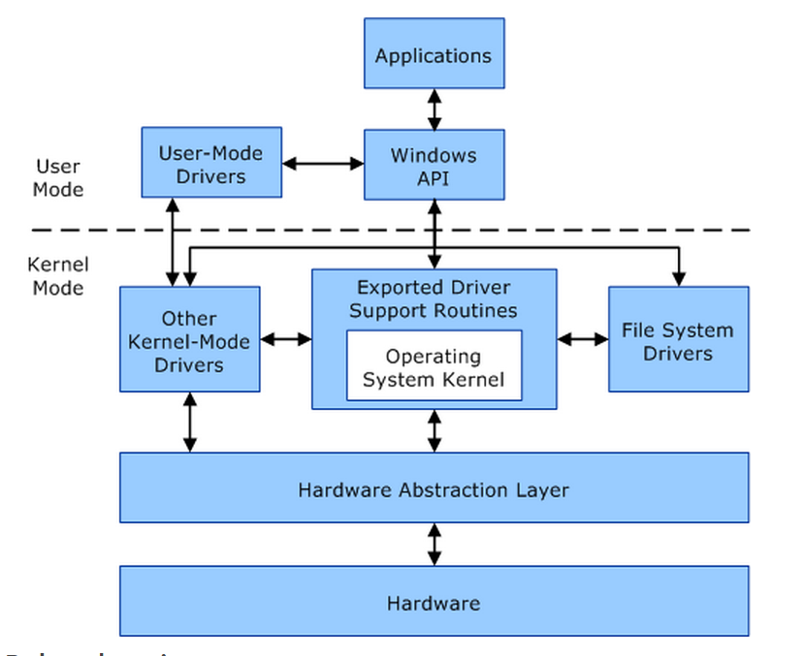
Device Management
Device Manager is a Control Panel applet in Microsoft Windows operating systems. It allows users to view and control the hardware attached to the computer. When a piece of hardware is not working, the offending hardware is highlighted for the user to deal with. The list of hardware can be sorted by various criteria.
For each device, users can:
Supply device drivers
Enable or disable devices
Tell Windows to ignore malfunctioning devices
View other technical properties

Slide 26
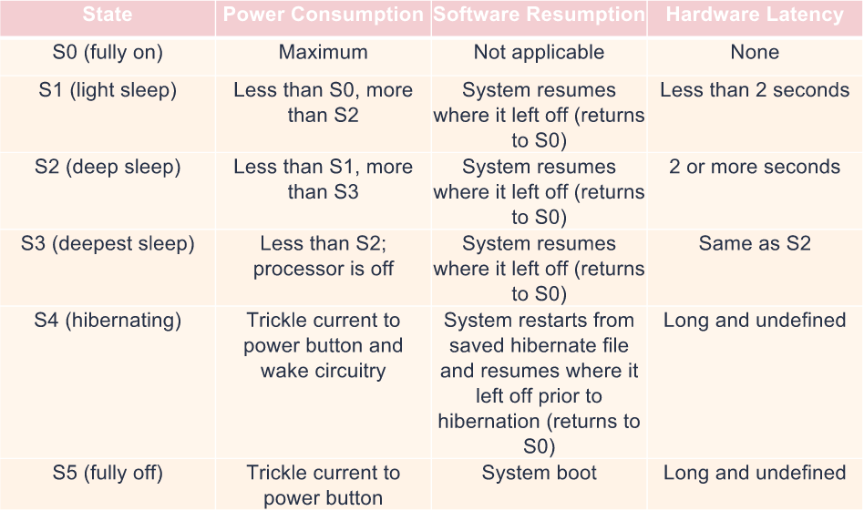
Power Management

Slide 27
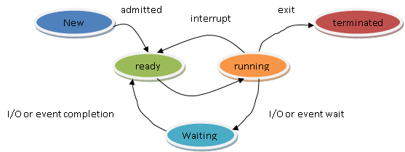
Process Management
A process is a software program that is currently running in windows.
A thread is an object that identifies which part of the program is running.
Process States :
New
Ready
Running
Waiting/blocked
Terminated

Slide 28
Virtual Memory
A computer can address more memory than the amount physically installed on the system. This extra memory is actually called virtual memory and it is a section of a hard disk that's set up to emulate the computer's RAM.
In computing, virtual memory (also virtual storage) is a memory management technique that provides an "idealized abstraction of the storage resources that are actually available on a given machine which "creates the illusion to users of a very large (main) memory.
Virtual memory Can be implemented using :
Demand Paging
Segmentation

Slide 29
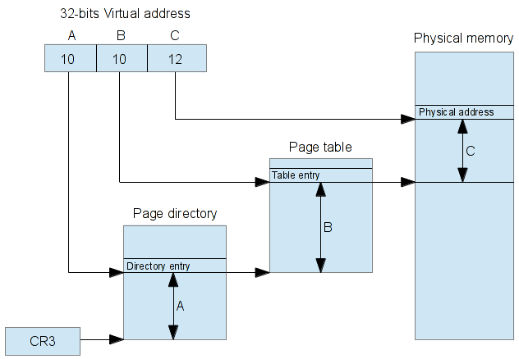
Virtual Address Space
In computing, a virtual address space (VAS) or address space is the set of ranges of virtual addresses that an operating system makes available to a process.
The range of virtual addresses usually starts at a low address and can extend to the highest address allowed by the computer.
VAS can be 4 bytes for 32-bit or 8 bytes for 64-bit OS versions.
This provides several benefits, one of which is, if each process is given a separate address space, security through process isolation.

Slide 30
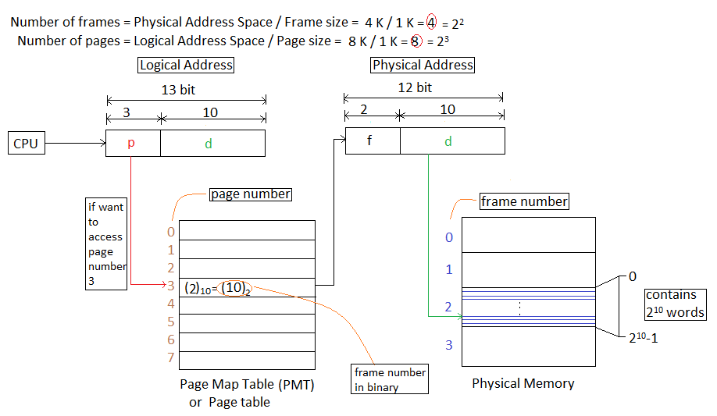
Paging
Paging is a memory management scheme by which a computer stores and retrieves data from secondary storage for use in main memory.
Data from secondary storage in same-size blocks called pages.
It is one of the virtual memory implementations.
When a program tries to reference a page not currently present in RAM, the processor treats this invalid memory reference as a page fault and transfers control from the program to the operating system.

Slide 31
Memory Pool
The memory manager creates the following memory pools that the system uses to allocate memory.
There are two types of memory pool :
Non-Paged Pool
Paged Pool
The nonpaged pool consists of virtual memory addresses that are guaranteed to reside in physical memory as long as the corresponding kernel objects are allocated.
The paged pool consists of virtual memory that can be paged in and out of the system. To improve performance, systems with a single processor have three paged pools, and multiprocessor systems have five paged pools.
The handles for kernel objects are stored in the paged pool, so the number of handles you can create is based on available memory.
The system records the limits and current values for its non paged pool, paged pool, and page file usage.

Slide 32
FUNDAMENTALS
OF
LINUX

Slide 33
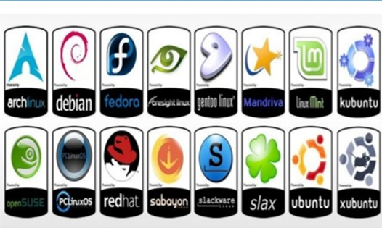
Linux OS
Linux is a name that broadly denotes a family of free and open source software OS built around the Linux kernel.
Linus Torwalds invented Linux in 1991 as a personal project.

Slide 34








Software Licensing
Freeware
Shareware
Free with Limited Features
Free for limited time
Commercial
Open Source
Full / Partial features on cost
Free / Cost with source code

Slide 35
GNU Project
The GNU Project is a free-software, first announced on September 27, 1983 by Richard Stallman at MIT.
UNIX like Operating System that includes kernel, compiler, editor, graphical interfaces, etc.
GNU/Linux System
GNU General Public License

Slide 36
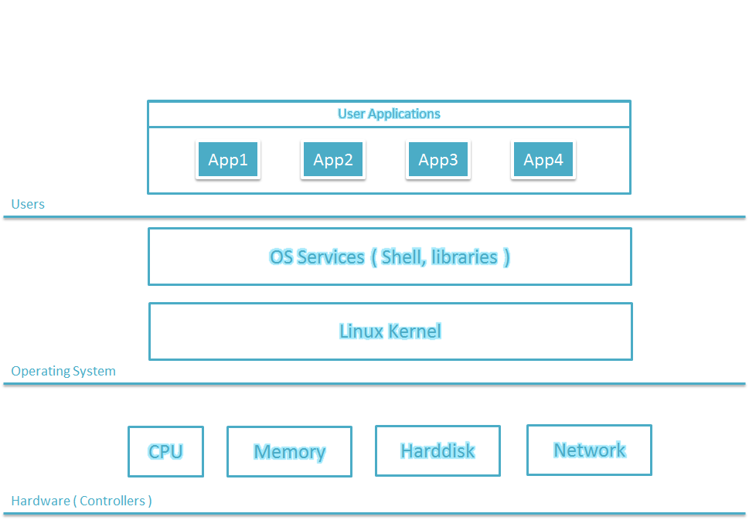
Linux Subsystem

Slide 37
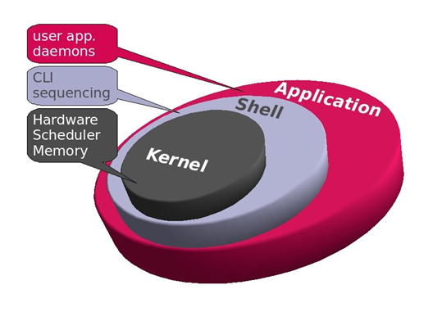
Linux Kernel
It is a bridge between application and the hardware.

Slide 38
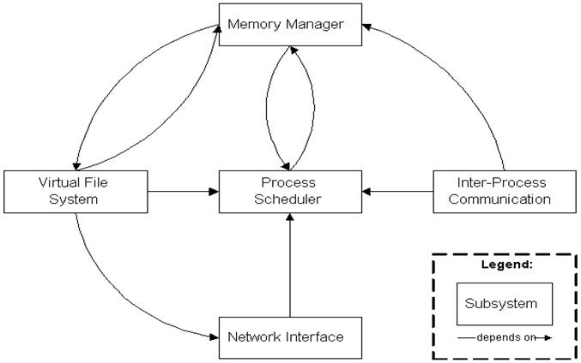
Kernel

Slide 39
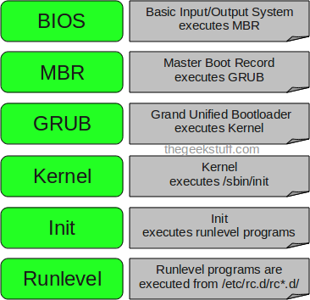
Linux Booting Process
Notes:
A cor AZUL sempre tem que aparecer no slide. Seja nas formas ou no texto.
Uma imagem como essa nao funciona. Muito “Barbie” para uma consultoria. Eles gostam deste layout mas deveria estar separador de capitulos com o logo de “espadas” maior. Para toda insercao de imagem o fundo deve ser cinza claro.

Slide 40
Linux Booting Process (Cont...)
LOAD STAGE 1.5 ,then STAGE 2 of GRUB
POWER ON
BIOS
LOAD STAGE 1 GRUB from MBR
KERNEL mounts ROOT FILE SYSTEM
GRUB Loads KERNEL image, and initial RAM disk
Present BOOT TIME MENU
GRUB reads menu.lst
KERNEL runs INIT
INIT runs scripts to start user level services

Slide 41
Linux Shell
Unix Shell :
A Unix shell is a command-line interpreter .
It provides a traditional user interface for the Unix operating system and for Unix-like systems.
Whatever you type at the command line is understood and interpreted by a program and then that program gives you an output after executing your command. This program that understands what you type is called the shell.
Types of Shell :
Ash
Bash
Corn
T - Shell
C- Shell
Z- Shell

Slide 42
Bash
Bash - Bourne Again Shell
Probably most advisable for beginning users while being at the same time a powerful tool for the advanced and professional use
Bourne Again Shell combines the advantages of the Korn Shell and the C Shell
It is the default on most Linux distributions.

Slide 43
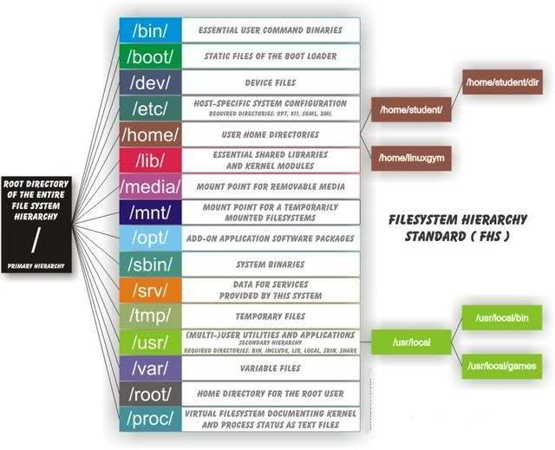
File Management

Slide 44
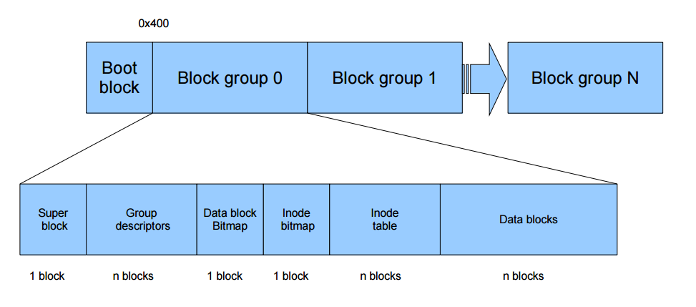
Structure of EXT4 File System

Slide 45
PROCESS MANAGEMENT
Process Scheduling
Refers to the way processes are assigned to run on the available CPU.
Functionality of Scheduler:
CPU UTILISATION
THROUGHPUT
TURNAROUND
WAITING TIME
RESPONSE TIME
FAIRNESS

Slide 46
TYPES OF SCHEDULING:
NORMAL
FIFO
Round Robin
Priority based scheduling
TYPES OF PROCESSES:
Interactive process
Batch or Automatic process
Real-time process
Zombie process
Orphan process

Slide 47
Interprocess Communication
Set of techniques for the exchange of data among multiple threads in one or more process.
Types of interprocess management :
SIGNALS
PIPES
Message queues
Semaphores
Shared memory

Slide 48
Device Management
Device Files :
A device file is an interface for a device driver that appears in a file system as it were an ordinary file.
Allows software to interact with the device driver using standard I/O system calls which simplifies many tasks.
Why use device files?
Device files allows transparent communication between user space applications and computer hardware.

Slide 49
Interrupt Management
IRQ(Interrupt Service Request):
Hardware lines over which devices can send interrupt signals to microprocessor.
Assign different IRQ address to different hardware devices because the interrupt signals run along single IRQ lines.

Slide 50
In Linux all devices were considered as files
File | Device
/dev/fd0 | Floppy disk
/dev/hda0 | IDE Hard drive 1, partition 0
/dev/hdb3 | IDE Hard drive 2, partition 3
/dev/sda | First SCSI hard drive
/dev/cdrom | CD ROM drive This device may be on the secondary controller as a master (/dev/hdc) or slave (/dev/hdd).
/dev/mouse | May be a pointer to /dev/psaux which is the ps2 device or /dev/cua which is a serial device or /dev/ttyS0
Disk Drives
/dev/hda | primary IDE master
/dev/hdb | primary IDE slave
/dev/hdc | secondary IDE master
/dev/hdd | secondary IDE slave

Slide 51
Memory Management
Concept of how efficiently we are using the physical and virtual memory.
LOGICAL COMPONENTS OF MEMORY MANAGEMENT:
LARGE ADDRESS SPACE:
The OS makes the system appear as if it has a larger amount of memory than it actually has.
Larger than the physical memory in the system.

Slide 52
PROTECTION:
The virtual address spaces are completely separate from each other and so a process running one application cannot affect another.
The hardware virtual memory mechanisms allows areas of memory to be protected against writing.
VIRTUAL MEMORY:
Method of providing the full address space by using a combination of RAM and hard disk is called as virtual memory.
Virtual - Appearing to exist but not really through.

Slide 53
MEMORY MAPPING:
Used to map image and data files into a process address space.
The contents of a file are linked directly into the virtual address space of a process.
DEMAND PAGING:
OS should not use physical memory inefficiently.
Technique of loading virtual pages into memory as they are accessed is known as demand paging.
Eg: Db query engine.

Slide 54
Swapping:
Swapping of pages from hard disk to physical memory.
Dirty pages
Swap file
Working set
Access control:
Page table entry
Use the access control information to check that the process is accessing memory in a way that it should.

Slide 55
Page allocation:
Buddy algorithm
Pages are allocated in blocks which are powers of 2 in size.
Page deallocation:
Recombines pages into larger blocks of free pages whenever it can.

Slide 56
Thank You!

